Slide 1

SALES DASHBOARD SUMMARY
PROFIT AND REVENUE ANALYSIS

Slide 2
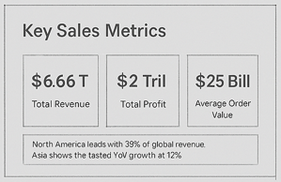
Key Sales Metrics
Our business achieved a total revenue of $6.66 trillion and a total profit of $2 trillion, driven by the sale of 2 billion units. The average order value stands at $25 billion, reflecting high-value transactions across regions. With a healthy profit margin of 29.50%, these figures indicate strong financial performance and profitability across key product categories and markets.

Slide 3
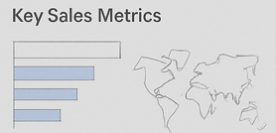
Key Sales Metrics By Product
Our sales performance is led by Cosmetics, the top-selling product category contributing significantly to our overall revenue. The company recorded $6.66 trillion in total revenue and $2 trillion in total profit, with 2 billion units sold. The average order value reached $25 billion, and we maintained a strong profit margin of 39.77%, reflecting exceptional product profitability and market response.

Slide 4
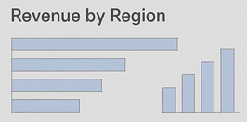
Revenue By Region
Sales distribution across regions reveals Sub-Saharan Africa as the highest contributor, followed closely by Europe and Asia. The revenue share highlights strong performance in emerging markets, indicating growth potential outside traditional regions. Strategic focus in these top-performing areas can further enhance profitability and market penetration.

Slide 5
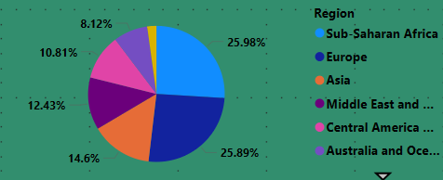
Top – Selling Categories
Cosmetics leads all product categories in total sales, followed by Household and Office Supplies. These high-performing categories consistently generate strong revenue and margins, highlighting consumer demand and effective sales strategies. Continued focus on these segments can drive sustained profitability and long-term growth.

Slide 6
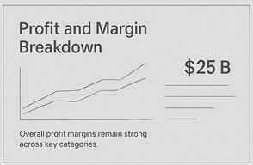
Profit Margin & Breakdown
Our overall profit margin stands at 29.50%, with the highest margins observed in Cosmetics and Household categories. The margin analysis indicates efficient pricing strategies and strong cost control in these segments. Maintaining focus on high-margin products while optimizing lower-margin ones can further boost total profitability.

Slide 7
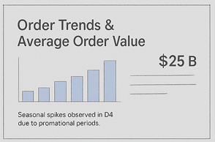
You’re an expert with Tell Me
Sales activity shows consistent order volume across all countries, with notable peaks during high-demand periods. The average order value is $25 billion, indicating bulk transactions and large-scale operations. While order counts remain stable, optimizing for order value and frequency presents opportunities for further growth and revenue scaling.

Slide 8
Explore without leaving your slides
Total Revenue reached $6.66 trillion, reflecting strong global sales performance.
Total Profit was $2 trillion, supported by high-margin product categories.
Average Order Value of $25 billion suggests high-value bulk transactions.
Cosmetics emerged as the top-selling category, both in revenue and profitability.
Sub-Saharan Africa leads regional revenue, followed by Europe and Asia.
2 billion units sold globally, showcasing operational scale and market reach.
Profit margin holds at 29.50%, indicating efficient cost and pricing strategies.
Consistent order volume observed across countries, with spikes in key periods.
High performance in Household and Office Supplies suggests product expansion opportunities.
Recommendation:
Focus on scaling in high-revenue regions, promote top-margin products, and enhance order frequency through customer retention strategies.

Slide 9
THANK YOU

